Slide 1

Weather App
Umar Mansoor ST10445996

Slide 2
Purpose of the app
This app has been created for the purpose of showing the local weather to the local people. It should help people plan their days in advance, with the help of the app showing the users what the maximum and minimum temperature of each day of the week should be, while also providing the users with information on the weather conditions (rainy, sunny, etc.)

Slide 3
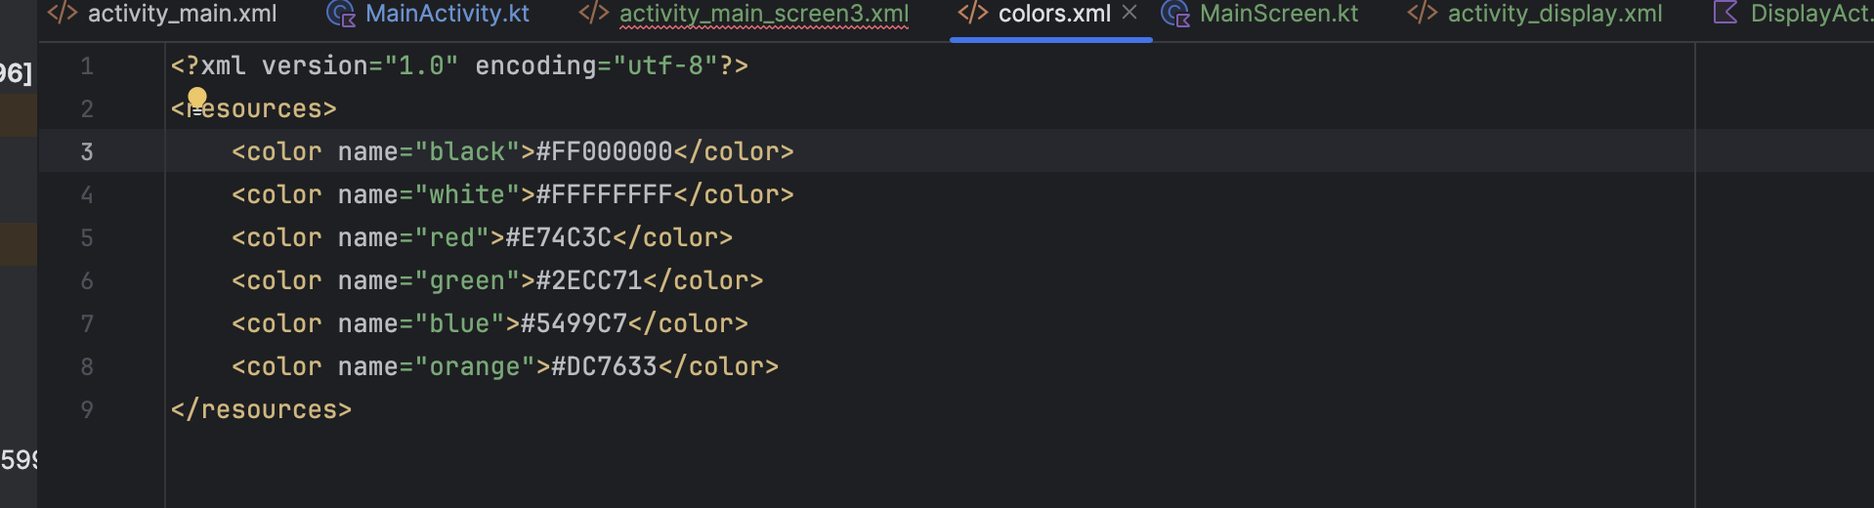
XML of my colour codes

Slide 4
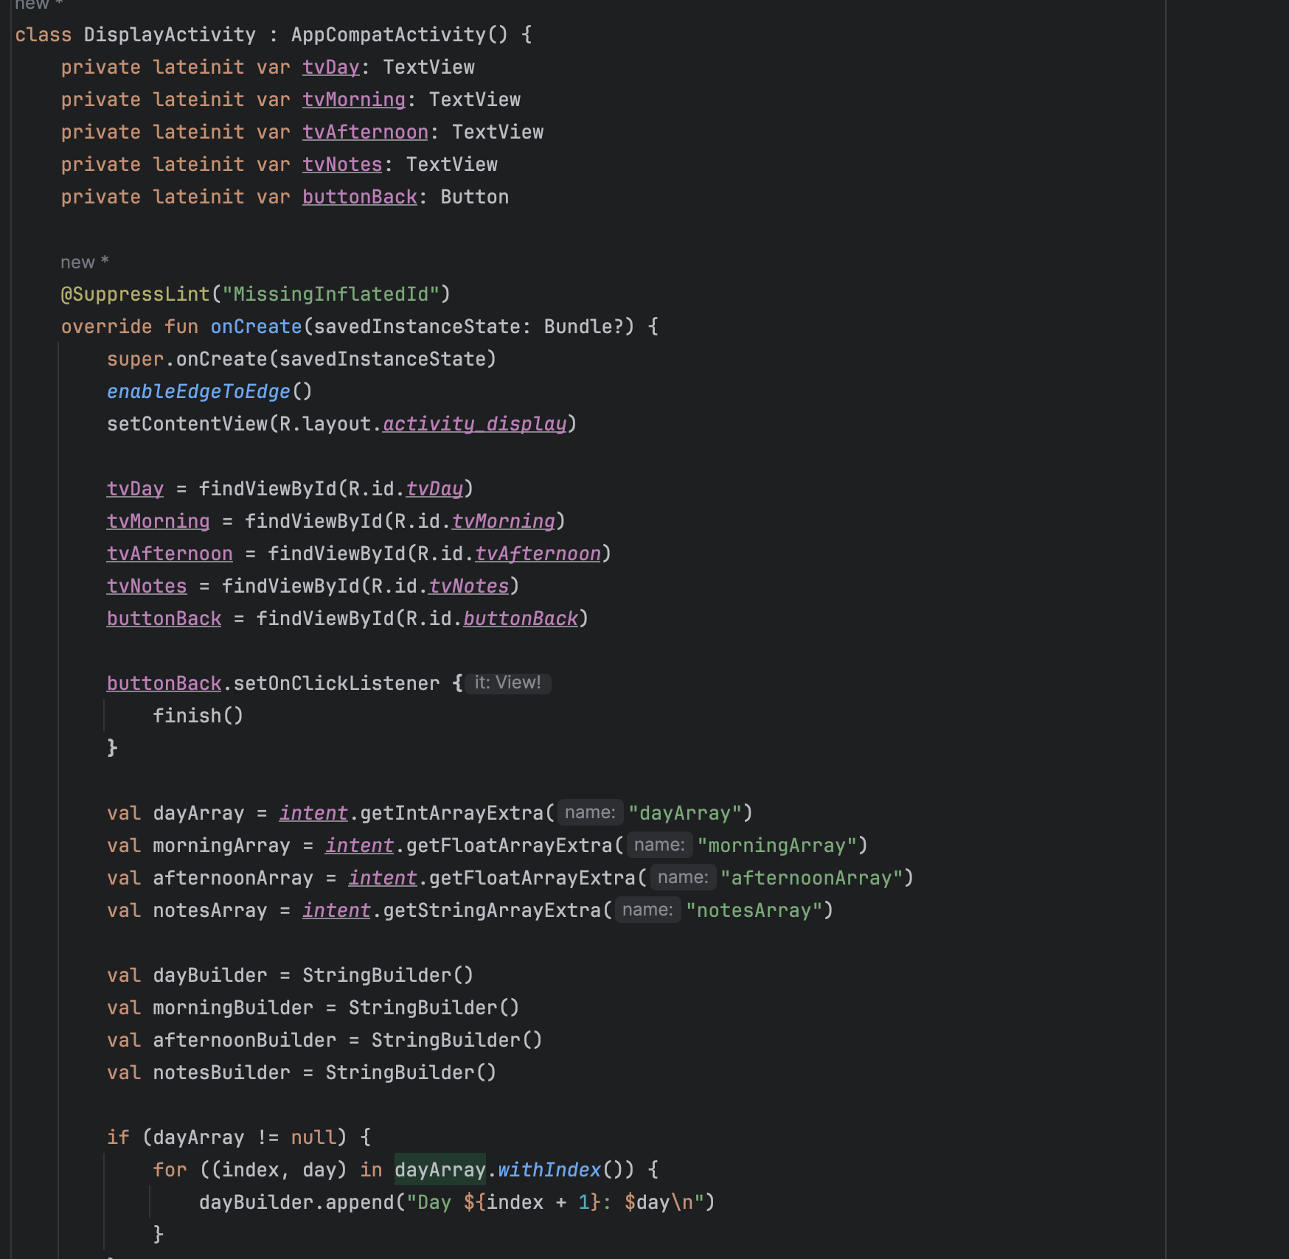
Main Activity codes for the Main Screen

Slide 5
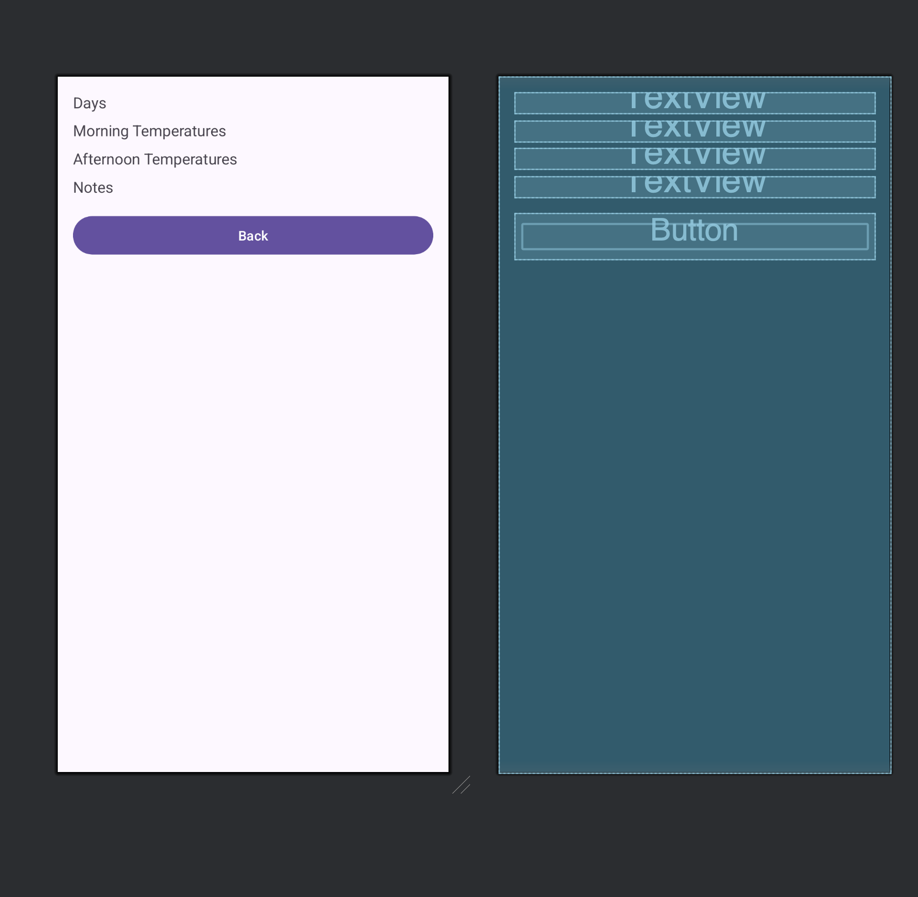
Button and Text views for the detailed view screen

Slide 6
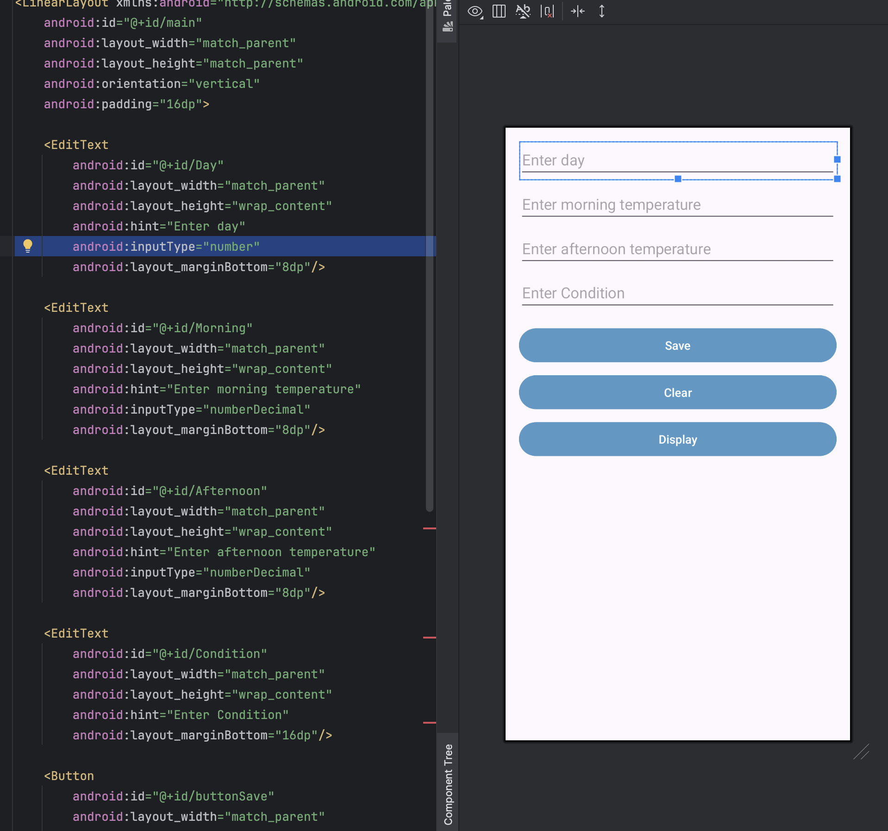
Xml of the main page, showing the buttons and the edit texts

